Slide 1
Revision of Policy on Academic Misconduct
Academic Integrity Committee
2015-2016

Slide 2
Why Revise Academic Misconduct Policy?
The current policy outlines a long and cumbersome process which discourages participation by faculty, and is not easily understood by students.
http://www.ccsu.edu/academicintegrity/policy.html

Slide 3
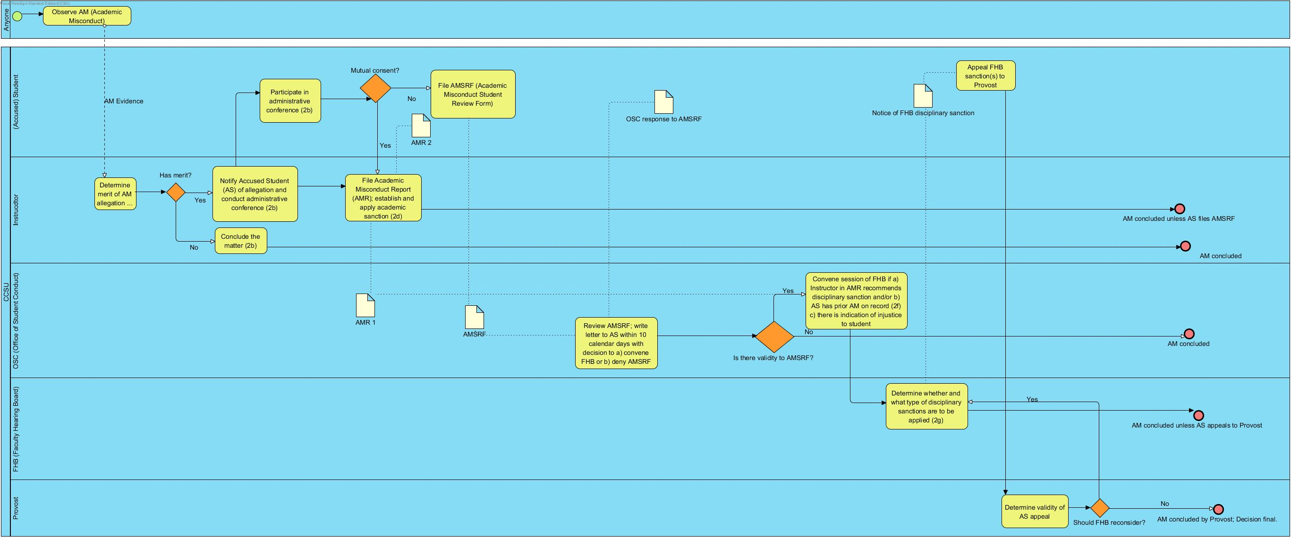

Slide 4
Proposed Changes:
Remove Department Chair as adjudicator of student appeal (AMSRF)
Have Office of Student Conduct handle student appeal (AMSRF)
Rationale: Contractually, the Department Chair is not the supervisor of faculty member. Removing formal participation of Chair simplifies and shortens process.

Slide 5
Proposed Changes:
Have Office of Student Conduct (in informal consultation with Provost) rule on student appeal (AMSRF)
Rationale: Involving the Office of Student Conduct and the Provost early on in the process is likely to send a strong message to all participating parties.

Slide 6
Proposed Changes:
Provost rules directly only in response to action of Faculty Hearing Board after student’s appeal.
Rationale: Administration should have the final say

